Slide 1
Shell Bootcamp 2024 3 Reflections for Week 1
Akshay Rai
Date : 30-Aug-2024

Slide 2

About Me
A man is made by the patience when the odds are against him

Slide 3

My learnings from this week!

Slide 4
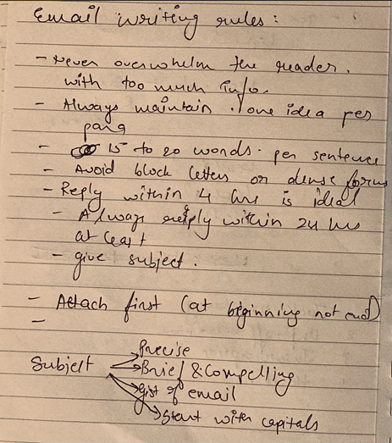
Learning 1 | My takeaways
From the sessions of professionalism I learnt how to be more reliable as a person and how to maintain a professional image. Besides this, I also learnt email etiquettes which taught me to communicate clearly.
My key takeaway was that how I can build trust, enhance collaboration, and ensure effective communication
In the Energy Sector, I personally see this concept crucial for managing global terms and time sensitive projects.

Slide 5
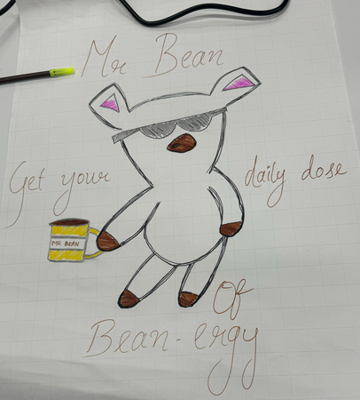
Learning 2 | My takeaways
By collaboratively designing our brand logo and brainstorming the tagline “Get your daily dose of Bean energy”, I learned the importance of trust building and working as a team.
We performed a roleplay for stakeholder management, which helped us understand the significance of it in the corporate world and that was my key takeaway.
In the energy sector these learnings are crucial for aligning diverse teams and stakeholders on project goals.

Slide 6
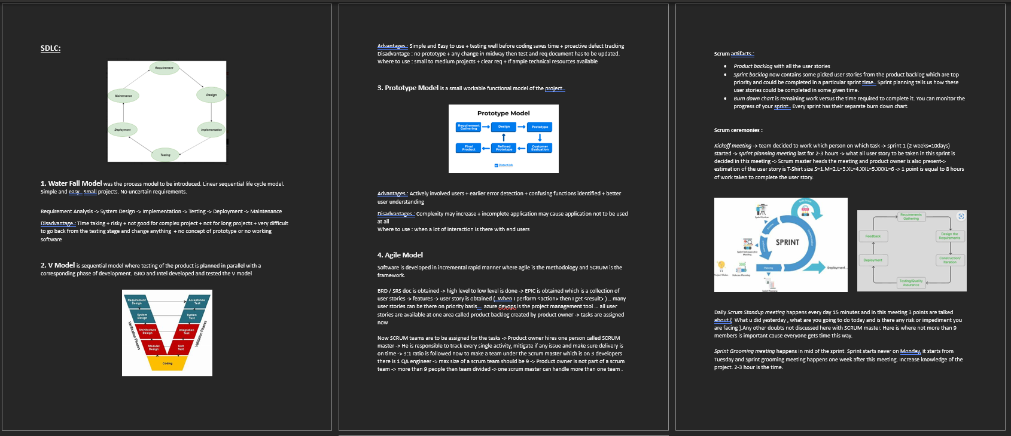
Learning 3 | My takeaways
I learnt about different software development models like waterfall model, V model, Prototype model and Agile model. Each of them had their own advantage & disadvantage
Key takeaways for me was that Business Analyst prepares BRD. Then SRS is prepared by the developers. Agile and Scrum methodologies allow rapid adjustments and feedback which ensures final product meets user needs.
In energy sector Agile and Scrum can manage projects like renewable energy installations or smart grid implementations.

Slide 7

Relevance of learnings for my organization

Slide 8
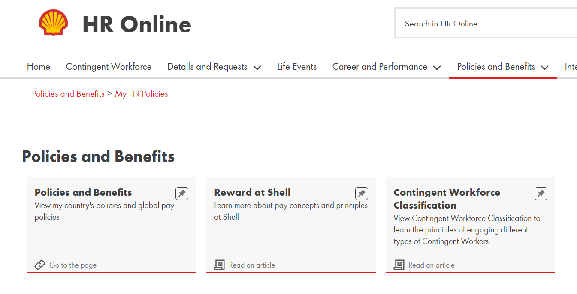
Learning 1 | Relevance for Shell
I feel Shell implements these learnings into their corporate culture through regular training and clear policies. They also do performance reviews to make sure that these learnings are implemented in the right way.
I feel these learnings enhance shell’s operational efficiency across it’s global operations and thus benefit shell.

Slide 9
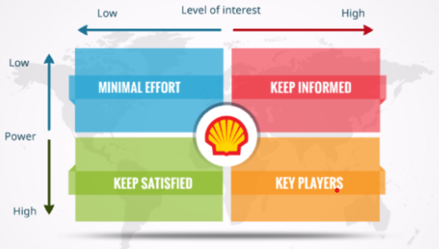
Learning 2 | Relevance for Shell
Shell implements these learnings by using a structured stakeholder engagement process and regular feedback loops to ensure trust.
By effectively managing stakeholders and building trust, Shell ensures smoother project execution and reduces conflicts as much as possible. Thus leading to a long term success and sustainability.

Slide 10
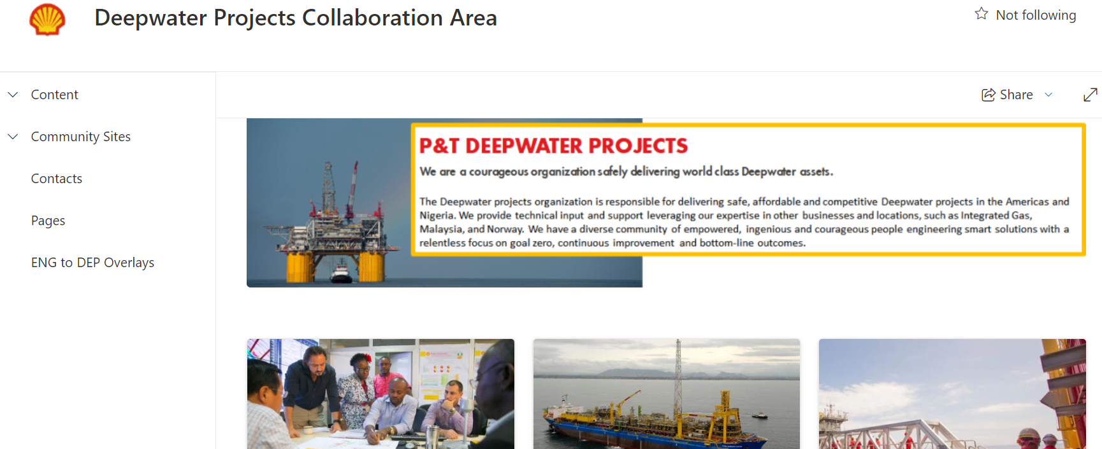
Learning 3 | Relevance for Shell
Shell implements these learnings by adopting Agile and Scrum methodologies to manage complex energy projects. Iterative development and continuous feedback in these models ensures that projects are aligned with stakeholder needs for Shell.
Shell benefits from these learnings by enhancing project efficiency, reducing risks and improving product quality. Thus, Market demands and customer expectations can be met easily.
.

Slide 11

Challenges in implementing learning

Slide 12
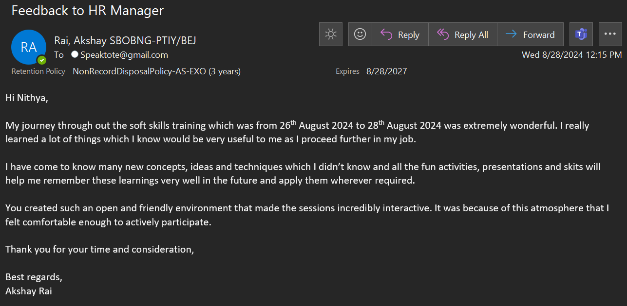
Challenge faced while implementing Learning 1
During my college years I often wrote formal emails. While my professors were lenient with minor mistakes, transitioning to the corporate world presented a new challenge. I felt a little nervous while writing an email to the HR for the first time. I found myself proofreading the email multiple times to ensure it was error free.
To overcome this I plan to seek mentorship from experienced colleagues and actively participate in Shell’s training programs.

Slide 13
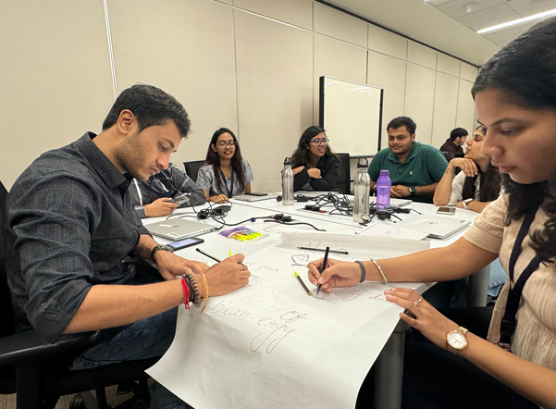
Challenge faced while implementing Learning 2
While performing the role play for stakeholder management, our scenario involved an energy company, and I represented the role of the local fisherman chief. Initially, I struggled to identify how he was a stakeholder and how he contributed to the business. However once we performed stakeholder identification, everything became clear.
My plan to overcome this challenge in future is to focus on thorough stakeholder analysis from the outset. This could include regularly engaging with stakeholders and seeking feedback.

Slide 14
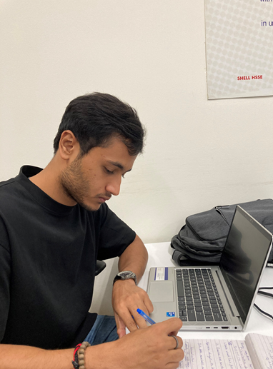
Challenge faced while implementing Learning 3
When tasked with preparing the BRD and SRS for Littelfuse, I initially focused on documenting product features and how the web app would outperform existing solutions. However, my BRD was discarded for lacking business significance.
To overcome this, I plan to deepen my understanding of Littelfuse’s business goals and clearly articulate the business value in the BRD, ensuring alignment with strategic objectives.
akshayrai14/Technical-Bootcamp: Shell Technical Training (github.com)
Here I was re-doing
the business significance
part for the Littel fuse webapp

Slide 15

Action Plan

Slide 16
My Action Plan for this Week
Actions
Timeline
Status
I plan to interact with my colleagues and team members.
I also plan to set up “Get To Know You” sessions with Shell employees and learn from their experiences.
I plan to implement these actions immediately to ensure a smooth transition into my role at Shell. Over the next 1-2 months, I will actively seek opportunities to do this.
I have had discussions with my line manager and buddy regarding my line of work. Additionally, I have met with members of the Native Software Engineering team, which is my line of business, and asked them all the questions I had about the onboarding process.

Slide 17

Learning is also Fun!

Slide 18
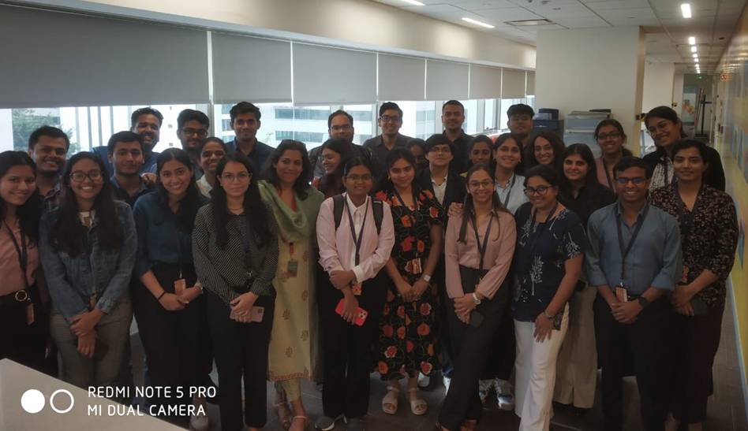
Learning is also Fun!
We chose Haldiram’s as our presentation topic after much brainstorming. During the presentation, I shared amusing anecdotes about how Haldiram’s marketed its products using the name of Bikaner’s king without permission. This made the class laugh, and our facilitator praised it as a good presentation skill, making the learning experience enjoyable.

Slide 19

Summary
This week, I learned about professionalism, grooming, corporate working style, stakeholder management, and teamwork, along with preparing effective BRD and SRS documents.
Next week’s focus on DBMS, software testing, DevOps, cloud, and case work is crucial for ensuring data management, software quality, efficient deployment, and practical application of theoretical knowledge.
The soft skills and documentation techniques from this week will enhance my ability to manage and implement the technical topics of next week effectively, ensuring seamless project execution.

Slide 20
Thank You

